Slide 1

Microsoft AL
GUI & In-Client Designer

Slide 2



Prerequisite
Use Workshop-VM / Workshop-Computer follow the instructions of the Boarding Pass
Visual Studio Code
https://code.visualstudio.com
Competence Team DevTech
Microsoft AL

Slide 3
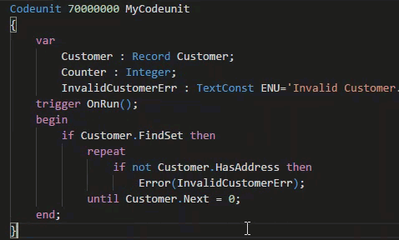
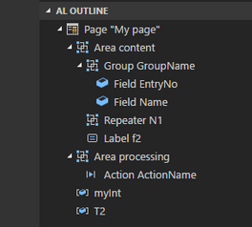
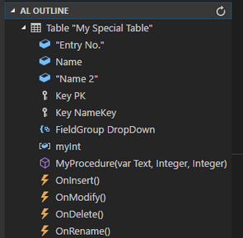
VS Code Useful Extensions
AL Formatter
Indentation
Keyword case style
Sort variable definitions
Readability Guidelines - Spacing and newlines (experimental)
AL Code Outline
Outlining – AL Object Structure
“Create List Page” from Table
“Create Card Page” from Table

Slide 4
GUI & In-Client Designer Agenda
1
Language & Types
2
In-Client Designer
3
Pages in Microsoft AL
4
Notification
5
Wizard & Assisted Setup

Slide 5

Microsoft AL
Language & Types
Page
Page Extension
Page Customization

Slide 6
Microsoft AL Language & Types
Recommendation for VS Code
1 File per Object
Organize Object Files in Folders (Pages, PageExtension, …)
Use Snippets in AL
ttable
tpageext
tcodeunit
…
Documentation - Development in AL
https://docs.microsoft.com/.../developer/devenv-dev-overview
C/Side | Microsoft AL
 | Extending | New
Codeunit | - | codeunit
Table | tableextension | table
Page | pageextension pagecustomization | page
XMLport | - | xmlport
Query | - | query
Report | - | report
Menu Suite | - | -
 |  | profile
 |  | controladdin

Slide 7
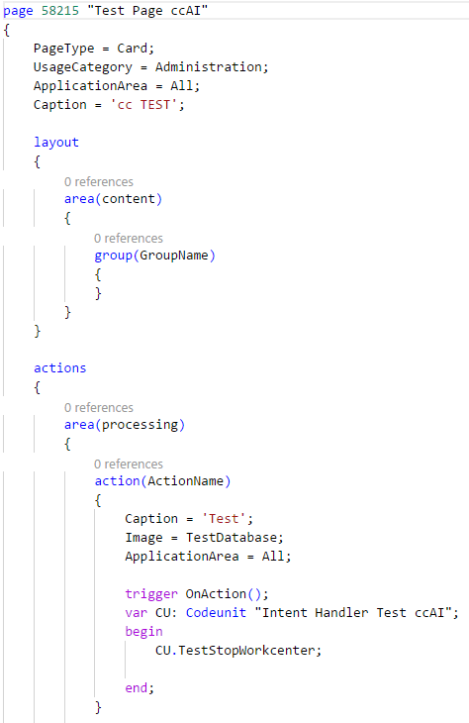
Microsoft AL Page
page <ID> „<Unique Name>“
Content Structure
Page Properties
Layout Section
Actions Section
Global Variables
Procedures & Events & Page-Triggers
Sections
Layout → Areas → Groups → Group-Properties & Fields → Field-Properties & Triggers
Action → Areas → Area-Properties & Actions → Action-Properties & Trigger

Slide 8
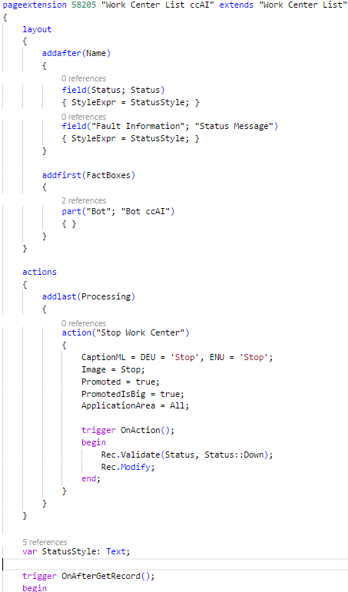
Microsoft AL Page Extension
pageextension <ID> “<Unique Name>” extends “< Target Page Name>” / or <ID>
Extensions / Modifications
Add addfirst(<ID>), addbefore(<ID>), addafter(<ID>), addlast(<ID>)
Move movefirst(<ID>), movebefore(<ID>), moveafter(<ID>), movelast(<ID>)
Modify modify(<ID>)
Changes in Sections
Layout → <Extension/Modification> → new / changed page content
Action → <Extension/Modification> → new / changed page actions
Additional Content
Global Variables
Procedures & Events & Page-Triggers

Slide 9
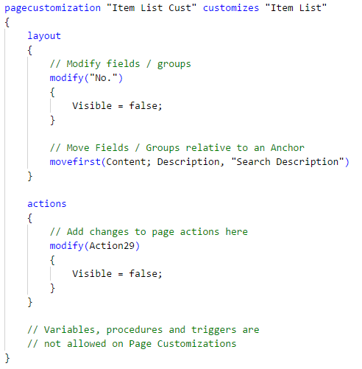
Microsoft AL Page Customization
pagecustomization “<Unique Name>” customizes “<Target Page Name>” / or <ID>
Modifications
Move movefirst(<ID>), movebefore(<ID>), moveafter(<ID>), movelast(<ID>)
Modify modify(<ID>)
Changes in Sections
Layout → <Modification> → changed page content
Action → <Modification> → changed page actions
No Additional Content!!!

Slide 10

In-Client Designer
WSIWYG Designer (Web Client)
Page Customization
Page Extension

Slide 11
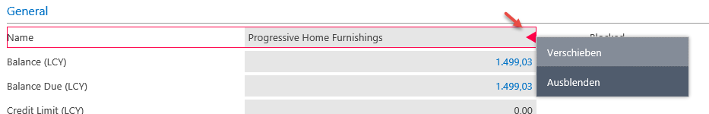
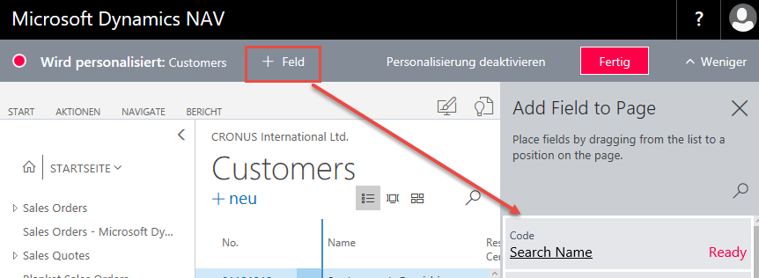
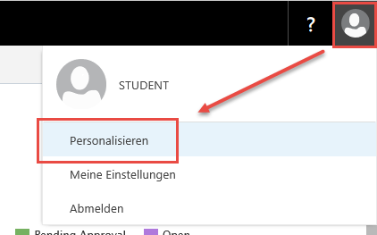
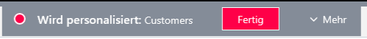
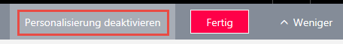
In-Client Designer Page Customization
Customization
Individual per User
On-Top of all modifications
User-Menu → Personalization
Actions
Show / Hide Fields
Move Fields

Slide 12
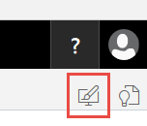
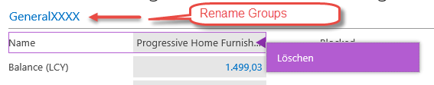
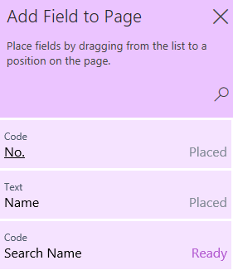
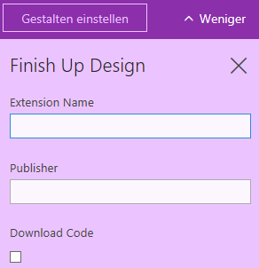
In-Client Designer Page Extension
Extension
For all Users
On-Top of all existing modifications except Customizations
Designer-Menu
Designer Actions
Rename Groups (e.g. Card Pages)
Add, Delete, Move Fields
Finish Up
Download Extension package (zip)

Slide 13
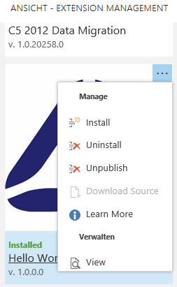
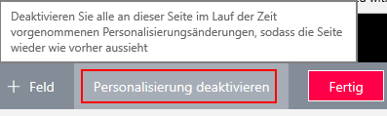
In-Client Designer Extension / Customization Management
Remove an Extension
Page “Extension Management”
Uninstall → “Deactivate”
Unpublish → Remove from System
Remove a Customization
Open Personalization → Deactivate the Personalization

Slide 14
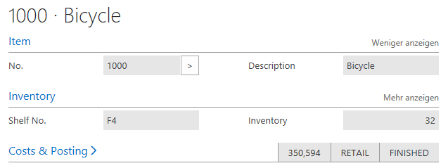
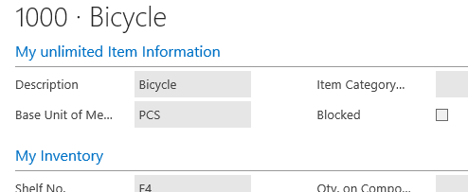
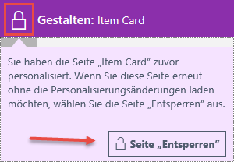
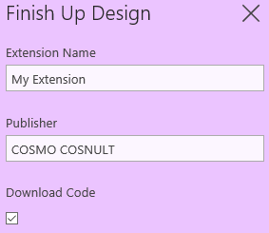
In-Client Designer Hands On
Open the Web Client
Personalize the „Item Card“
Hide some Fields
Rearrange some Fields
Save the Customization
Create an Extension for the Item Card
Unlock Designer when necessary
Rename the Item Group
Rearrange some Fields / Factboxes
Add Fields if you want
Finish the Extension and Download the Package

Slide 15

Pages in Microsoft AL
Microsoft AL Page Design
Page Properties
Layout, Action, Triggers

Slide 16
Microsoft AL Page Properties
PageType
Card, List, RoleCenter, Card Part, List Part, API, …
SourceTable / SourceTableView
SourceTableView = order(ascending) where (Code = const(‘PROD'));
ApplicationArea Application Area for the Page WebClient SearchPage
All, Basic, Suite, Advanced
UsageCategory Department for the Page WebClient SearchPage
None, Lists, Tasks, ReportsAndAnalysis, Documents, History, Administration
CardPageId

Slide 17
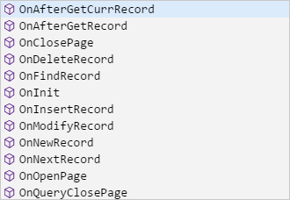
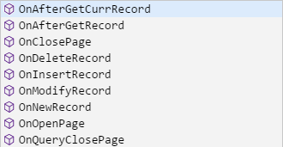
Microsoft AL Page / Page Extension - Triggers
Page - Triggers (Picture 1)
Same Triggers as in C/Side
Page Extension - Triggers (Picture 2)
less Triggers as Pages
Microsoft: “…triggers are called "closer" to the original trigger than the events…”

Slide 18
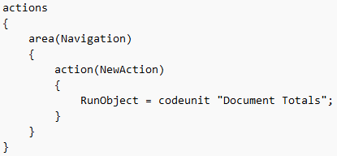
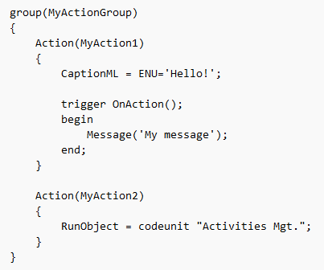
Microsoft AL Page Actions
Properties equal to C/Side
Image
Promoted / PromotedOnly / PromotedIsBig / PromotedCategory
Ellipsis
ApplicationArea All, Basic, Suite, Advanced
InFooterBar (Wizards)
RunObject & RunPageView RunObject = page “Target Page” RunPageView = order(ascending) where(“Target Rec Field" = field(“Source Field"));
Trigger
OnAction();

Slide 19

It’s Lab Time
Hands On
New Table & Table Extension
New Page & Page Extension

Slide 20
Pages in Microsoft AL Hands On
Material
Project Skeleton „02-GUI-&-In-Client-Designer\Starter\02 My Favorit Beer\”
Tables: “Beer Category”
Tables.Extensions: “Cutomer”, “Item”
Prerequisites
Connect to your Workshop VM → use Instructions on your Workshop Boarding Pass
Hand On - Tasks
Create a Card Page and a List Page for Table “Beer Category”
Create a Page Extension (Card & List) for Table Extension “Customer”
Create a Page Extension (Card & List) for Table Extension “Item”

Slide 21
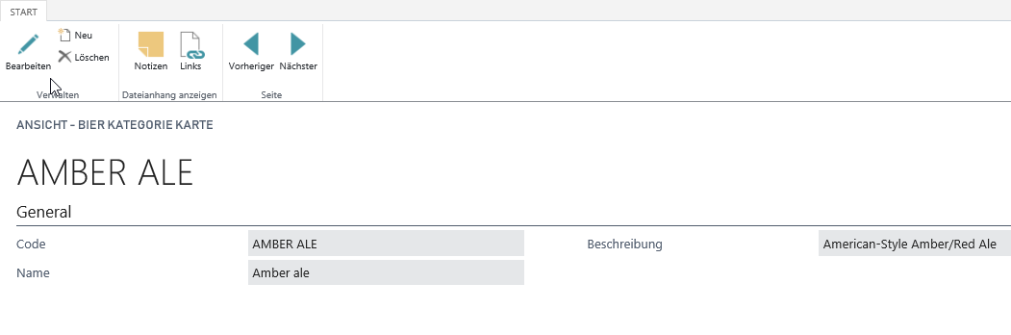
Pages in Microsoft AL Hands On – Card Page
Create a Card Page „Beer Category Card [CC]“ ID: 50201
Setup the Properties for the Page
PageType Card
UsageCategory Documents
ApplicationArea All
SourceTable „Beer Category [CC]“
SourceTableView sorting: „Code“ order: ascending
CaptionML ENU + DEU
Layout
Add all fields of the table to the layout area „content“ in a group „General“
Setup field properties (e.g. ApplicationArea)

Slide 22
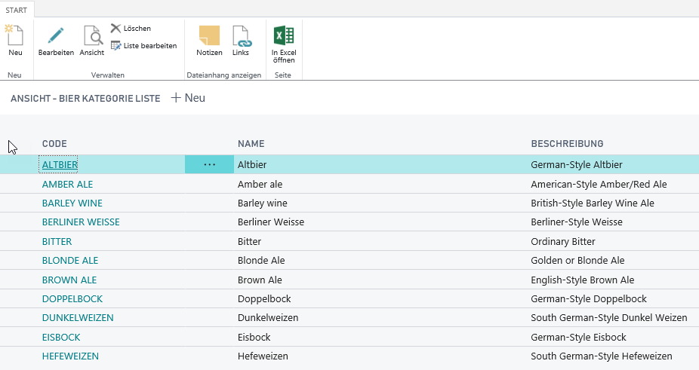
Pages in Microsoft AL Hands On – List Page
Create a List Page „Beer Category List [CC]“ ID: 50202
Setup the Properties for the Page
PageType List
UsageCategory Lists
ApplicationArea All
SourceTable „Beer Category [CC]“
SourceTableView sorting: „Code“ order: ascending
CaptionML ENU + DEU
CardPageId "Beer Category Card [CC]“
Layout
Add all fields of the table to the layout area „content“ in a repeater „General“
Setup field properties (e.g. ApplicationArea)

Slide 23
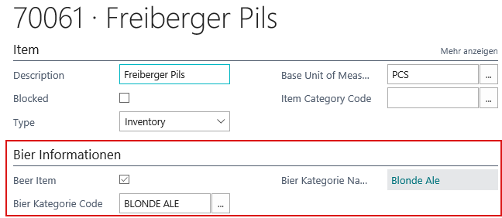
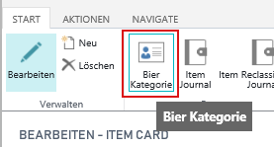
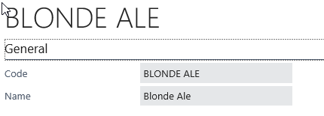
Pages in Microsoft AL Hands On – Page Extension
Create a Page Extension „Item Card [CC]“ extends “Item Card” ID: 50200
Layout
Add a group “Beer” behind the “Item” group
CaptionML ENU + DEU
Add the “Beer” fields
Hide “Beer Category Group“ & „Beer Category Group Name“, when the item is not marked as „Beer Item“
Actions
Add an action to show the “Beer Category Card“
Use Properties: CaptionML, ApplicationArea, Visible, RunObject, RunObjectView, Promoted, Image

Slide 24
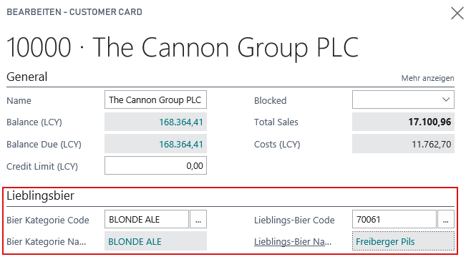
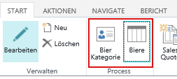
Pages in Microsoft AL Hands On – Page Extension
Create a Page Extension „Customer Card [CC]“ extends “Customer Card” ID: 50201
Layout
Add a group “Favorite Beer” behind the “General” group
CaptionML ENU + DEU
Add the “Beer” fields from record “Customer”
Actions
Add an action to show the “Beer Category Card“
Add an action to show the possible “Beer Items“

Slide 25

Improve the UX
Features
Notification
Assisted Setups (Wizard)

Slide 26
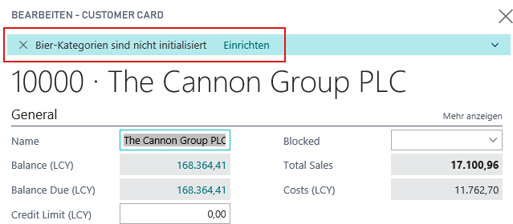
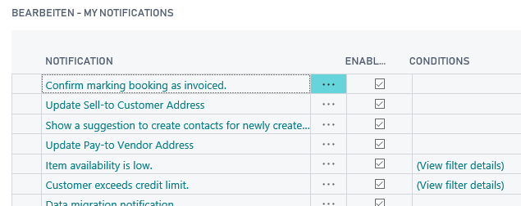
Pages in Microsoft AL Improve the UX
Notifictation “… programmatic way to send non-intrusive information to the User Interface (UI)…”
ID Guid
Message
Scope Local / Global
Actions
GetData(…) / SetData(…)
Configurable
Record "My Notifications“ → IsEnabled(…) / IsEnabledForRecrod(…)

Slide 27
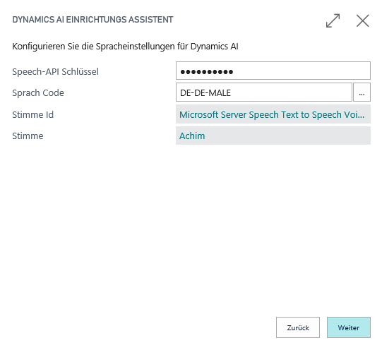
Pages in Microsoft AL Improve the UX
Wizards
Object Type Page (Navigation)
Groups InstructionalText
Actions
Back, Next, Finish Visibility depends on Page
Properties InFooterBar
Groups = Wizard Pages Show / Hide for each Page
Start Page / Welcome Introduktion
Page XYZ
Finish Page Summary

Slide 28
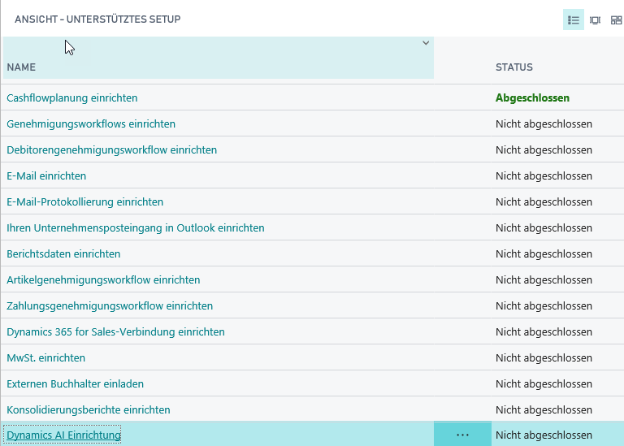
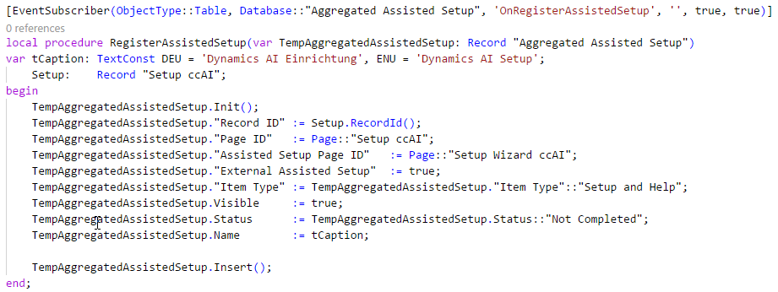
Pages in Microsoft AL Improve the UX
Assisted Setup
Registration of individual Setups
Register a Page / Wizard
Record “Aggregated Assisted Setup”
Event “OnRegisterAssistedSetup”

Slide 29
It’s Lab Time
Hands On
Notification
Wizard

Slide 30
Pages in Microsoft AL Hands On
Material
Project Skeleton „02-GUI-&-In-Client-Designer\Starter\02 My Favorit Beer\”
Tables: “Beer Category”
Tables.Extensions: “Cutomer”, “Item”
Assets
“BeerCategories.json”
Prerequisites
Connect to your Workshop VM → use Instructions on your Workshop Boarding Pass
Hand On - Tasks
Invoke a Notification, when the selected Beer does not match the Customers Favorite Beer Category
Create a Setup Wizard to initialize Beer Categories and use a List Part for Table “Beer Category”
Invoke a Notification, when Beer Categories are empty and start the Wizard by a Notification Action

Slide 31
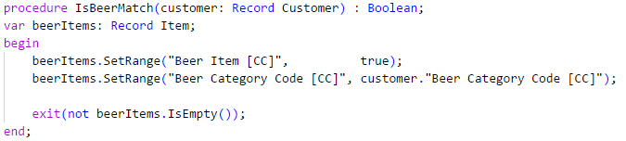
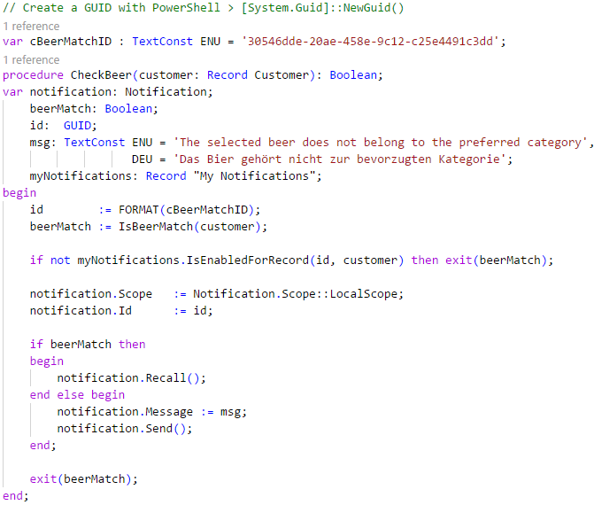
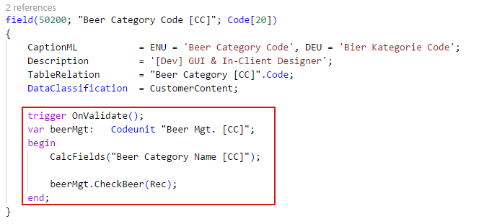
Pages in Microsoft AL Hands On – Notification
Create a Code Unit „Beer Mgt. [CC]“ ID: 50201
Add 2 Methods
IsBeerMatch … check the correctness of the beer
CheckBeer … use the check and show a notification
Use the codeunit from table extension “Customer [CC]” to check and invoke a notification

Slide 32
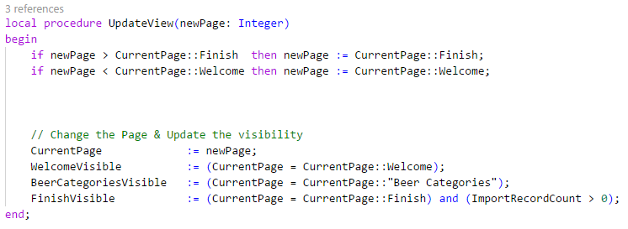
Pages in Microsoft AL Hands On – Wizard
Create a Page „Beer Wizard [CC]“ ID: 50200
Add 1 Variable (Option) CurrentPage "Welcome", "Beer Categories", "Finish"
Add 3 Variables (Boolean) WelcomeVisible, BeerCategoriesVisible, FinishVisible
Add 3 Pages (Groups) "Welcome", "Beer Categories", "Finish" Caption, InstructionalText, Visible …
Add 3 Actions Back, Next, Finish
Manage the visible Page by this method and check the result

Slide 33
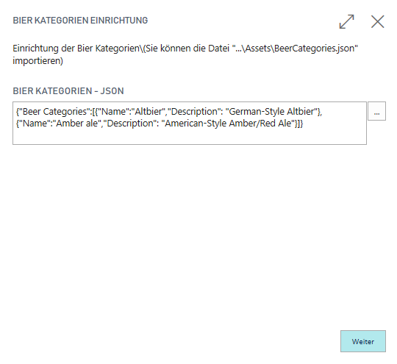
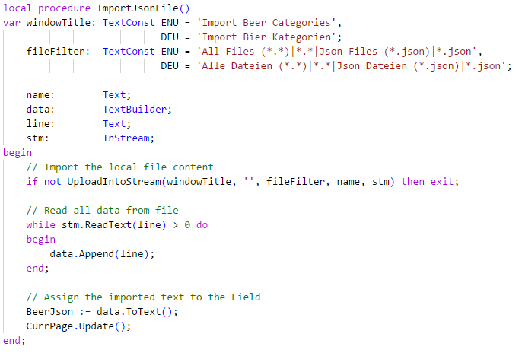
Pages in Microsoft AL Hands On – Wizard
Page "Welcome“
Add and Initialize a Multiline Textfield with a Json content
Add an Assisted Edit trigger to the field, which import (read) the Json content from File into the variable

Slide 34
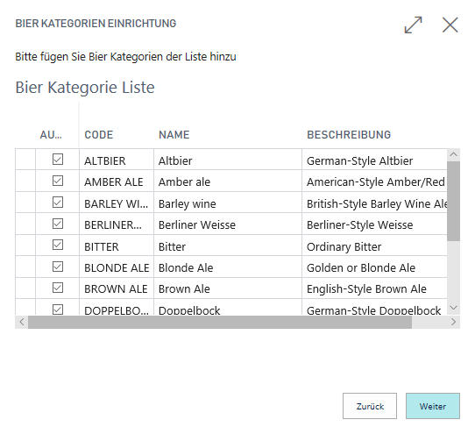
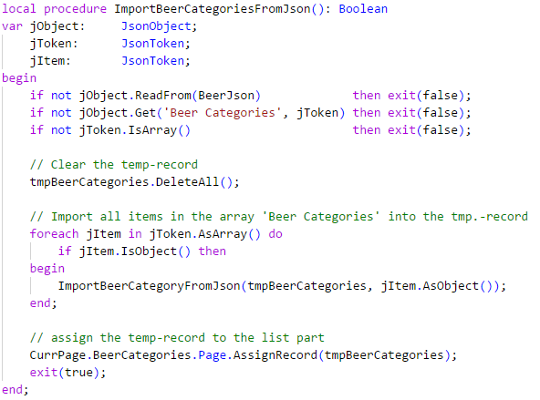
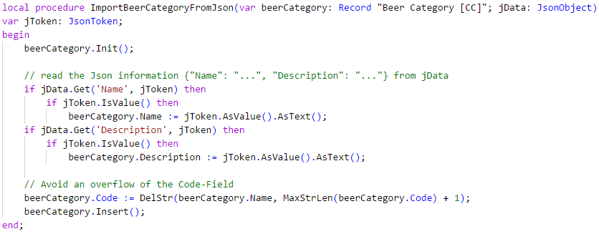
Pages in Microsoft AL Hands On – Wizard
Page “Beer Categories“
Add a List Part “Beer Category Sub [CC]” ID 50203 which allow the selection of categories
Add a temp. Record “Beer Category [CC]” to the wizard
Read the Json Content into the record during page change “Welcome” → “Beer Categories”
Assign the Record to the List Part

Slide 35
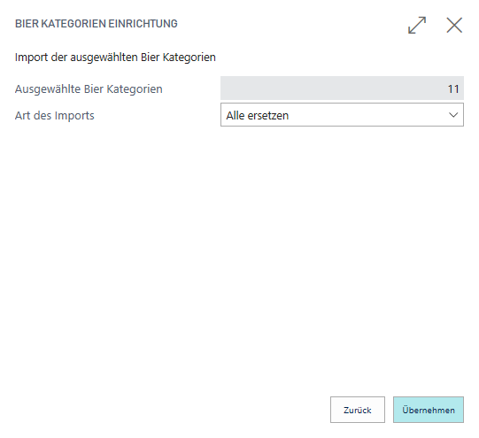
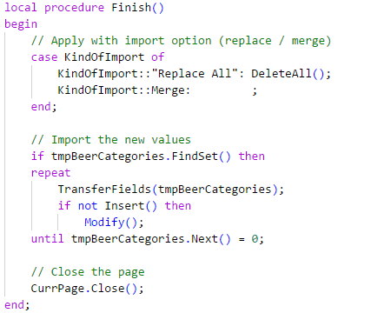
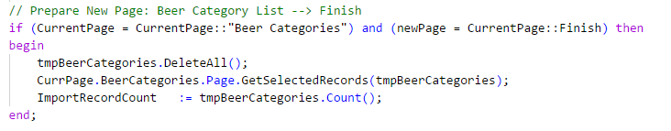
Pages in Microsoft AL Hands On – Wizard
Page “Finish“
Add an Information Field “Count of Selected Records”
Add an Option Field with values “Replace All” and “Merge”
Update the value of the Information Field, when the page changes “Beer Categories” → “Finish”
Use the Option Information, when the user press “Finish” and apply the content of the temp. record “Beer Categories” to the database and close the wizard

Slide 36
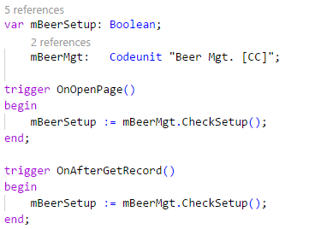
Pages in Microsoft AL Hands On – Notification
Use Code Unit „Beer Mgt. [CC]“ ID: 50201
Add some Methods to achieve this task: “Show a notification, when the record “Beer Categories” is empty and call the “Beer Wizard” from the notification by using an action”
Methods can be
IsBeerSetupComplete … check if record “Beer Categories” is empty
CheckBeerSetup … use the check and show a notification
StartBeerSetup … callback method for the notification action
Use the codeunit from “Customer Card [CC]” and invoke a notification

Slide 37

Q & A
Visual Studio Code
https://code.visualstudio.com
Competence Team DevTech
Channel Microsoft AL

